Slide 1
CONTROL STRUCTURES

Slide 2
Outline
Control structure
  Decision Statements
    If statement
    If-else statement
    Switch statement

Slide 3
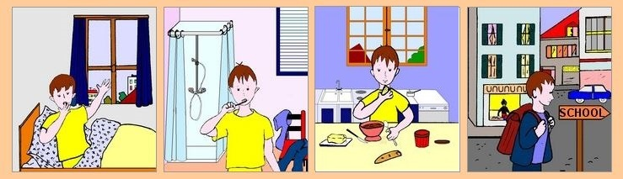
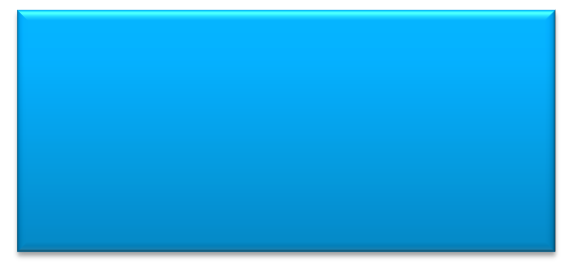
Program
Program is a set of instruction executed one by one.
Depending upon the circumstances sometimes it is desirable to alter the sequence of execution of statements.
1. Wake up;
2. Get ready;
3. If you have enough time, then eat breakfast;
4. Go to school.

Slide 4
Control Statements
The C language programs, until now follows a sequential form of execution of statements.
C language provides statements that can alter the flow of a sequence of instructions. These statements are called control statements.
These statements help to jump from one part of the program to another. The control transfer may be conditional or unconditional.

Slide 5
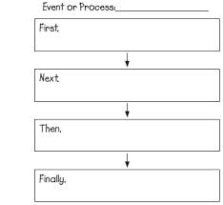
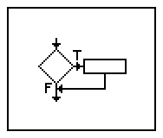
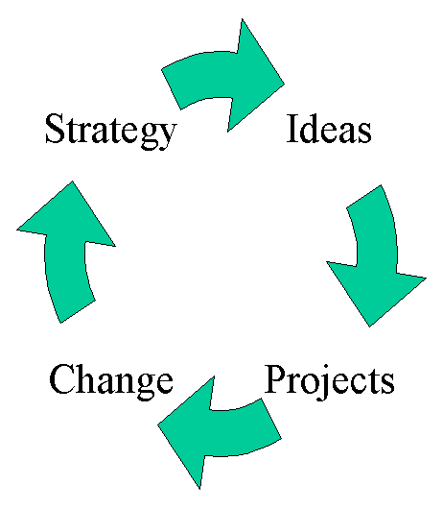
Control Structure
A control structure refers to the way in which the programmer specifies the order of executing the statements.
Three control structures
  Sequence structure
    Programs are executed sequentially by default.
  Selection structures
    if, if…else, switch
  Repetition structures (iteration)
    while, do…while, for
Notes:
Sequence- all statements are executed in the order as it is written
Selection- Different sets of statements are executed based on one or more conditions
Iteration- Certain set of statements are executed repeatedly

Slide 6
Condition Statements
The C condition statements or the decision statements are one which checks the given condition
Based upon the state of the condition, a sub-block is executed.
Decision statements are the:
  if statement
  if-else statement
  switch statement

Slide 7


Daily routine
Start
Go!!!
Where
To
Go?
Class
Movie
Stop
Stop

Slide 8

if statement
Quick yak:
Quiz upon for more sequence jumping procedures followed in daily life like:
Jumping a queue
Not attending a class
Based on conditions
Yes
If you have time?
No

Slide 9
if Statement
If statement
  It is decision making statement uses keyword if.
  It allows the computer to evaluate the expression first and then, depending on whether the value is ‘true’ or ‘false’, i.e. non zero or zero it transfers the control to a particular statement.
A decision can be made on any expression.
zero - false
nonzero - true
Example:
3 < 4 is true

Slide 10
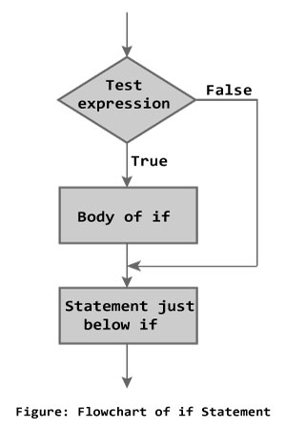
if Statement
Syntax
if (expression)
statement;
or
if (expression)
{
block of statements;
}

Slide 11
if Statement
The if statement has the following syntax:
The condition must be a
boolean expression. It must
Evaluate to either non-zero or zero.
if is a C
reserved word
if ( condition )/* no semi-colon */
statement;
If the condition is non-zero, the statement is executed.
If it is zero, the statement is skipped.

Slide 12


Rain ???
Is it going to rain?
Look up sky for clouds
yes
Clouds?
no
No rain
Raining

Slide 13
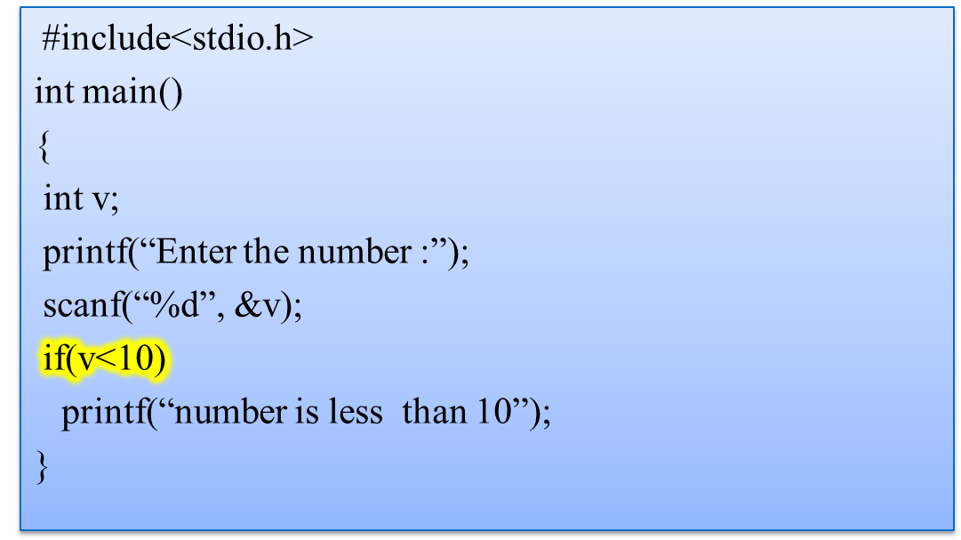
Program to check whether number is less than 10.
OUTPUT:
Enter the number: 6
Number is less than 10

Slide 14
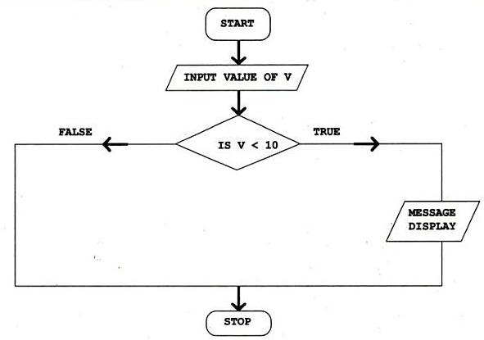
Control Flow

Slide 15
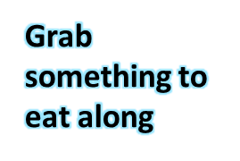

if..else statement
Yes
If you have time?
No

Slide 16
If..else statement
The if statement executes only when the condition following if is true.
It does nothing when the condition is false.
The if..else statement takes care of the true and false conditions.

Slide 17
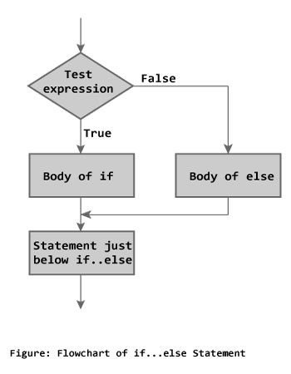
if..else statement
if..else has two blocks.
One block is for if and it is executed when condition is non-zero(true).
The other block is of else and its executed when condition is zero (false).
if (expression)
{
block of statements;
}
else
{
block of statements;
}
Syntax

Slide 18
if..else statement
The else statement cannot be used without if.
No multiple else statements are allowed with one if.
else statement has no expression.
Number of else cannot be greater than number of if.

Slide 19
Ternary conditional operator (?:)
C code:
    if ( marks>= 60 )
    printf( "Pass\n");
    else
    printf( "Fail\n");
Same code using ternary operator:
  Takes three arguments (condition, value if true, value if false)
  Our code could be written:
    printf("%s\n", marks>= 60 ? "Pass" : "Fail");
  Or it could have been written:
    marks >= 60 ? printf(“Pass\n”) : printf(“Fail\n”);

Slide 20
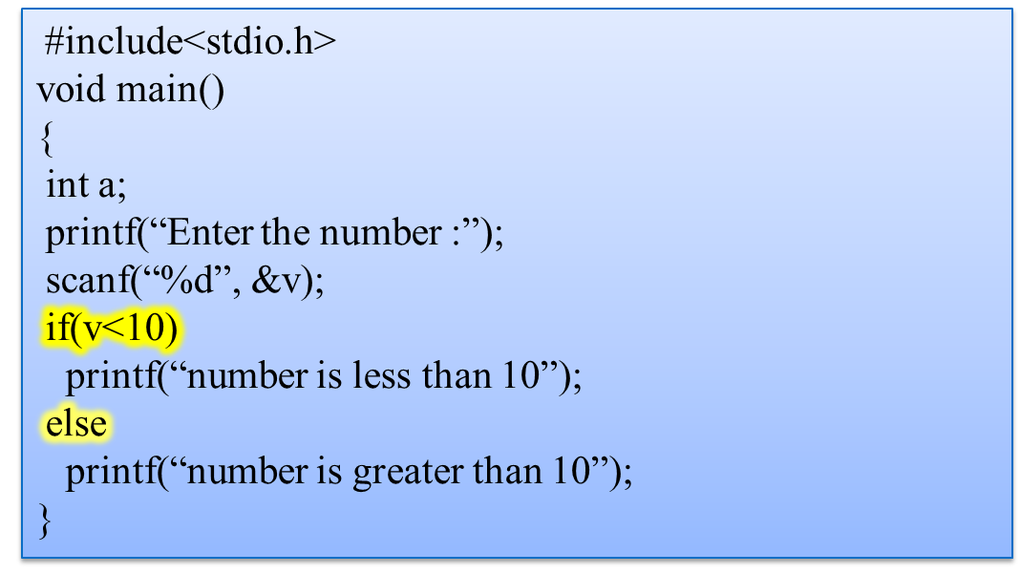
Program to check whether number is less than 10.
Enter the number: 7
Number is less than 10
Enter the number: 100
Number is greater than 10
or

Slide 21
Control Flow
MESSAGE
DISPLAY

Slide 22
Nested if..else
In if..else statement, else block is executed by default after failure of if condition.
The nested if...else statement is used when program requires more than one test expression.
  Test for multiple cases by placing if…else selection statements inside if…else selection statement.
This kind of nesting will be unlimited.

Slide 23
Nested if..else
if ( condition 1 )
{
block of statements;
}
else if ( condition 2 )
{
block of statements; }
else {
block of statements;
}
Syntax

Slide 24
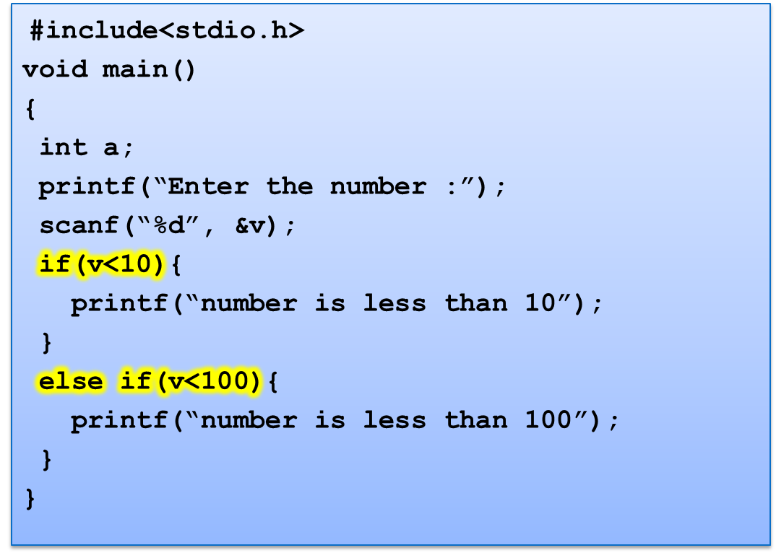
Program to check whether number is less than 10.
Enter the number: 1
Number is less than 10
Enter the number: 56
Number is less than 100
or

Slide 25
Forms of if
The if statement can take any of the following forms:
if ( condition )
do this ;
or
if ( condition )
{
do this ;
and this ;
}
if ( condition ) {
do this ;
and this ;
}
else {
do this ;
and this ;
}
if ( condition )
do this ;
else
do this ;
if ( condition )
do this ;
else if ( condition )
do this ;
else {
do this ;
and this ;
}

Slide 26
Program to print grades of students marks.
#include<stdio.h>
void main( )
{
float marks;
scanf(“%f”, &marks);
if (marks>90){
printf(“Grade A”);
}
else if (marks>80)
{
printf(“Grade B”);
}
else if(marks>70)
{
printf(“Grade C”);
}
else if (marks >60)
{
printf(“Grade D”);
}
}
66.70
Grade D
78.00
Grade C
or

Slide 27
Forms of if
Decision control statements | Syntax | Description
if | if (condition){ Statements;} | In these type of statements, if condition is true, then respective block of code is executed.
if…else | if (condition){ Statement1; Statement2;} else { Statement3; Statement4;} | In these type of statements, group of statements are executed when condition is true. If condition is false, then else part statements are executed.
Nested if | if (condition1){ Statement1;} else if(condition2){ Statement2;} else Statement 3; | If condition 1 is false, then condition 2 is checked and statements are executed if it is true. If condition 2 also gets failure, then else part is executed.
Quick yak:
Some daily routine examples are:
If: one class is not attended the % attendance goes down by a specific value
If…else: Grades to be assigned on the basis of marks
Nested If: selection of ice cream from group based on flavor, price and availability

Slide 28
break statement
break is a keyword.
break allows the programmer to terminate the loop.
A break statement causes control to transfer to the next statement after the loop or block.
The break statement can be used in nested loops. If we use break in the innermost loop then the control of the program is terminated only from the innermost loop.

Slide 29
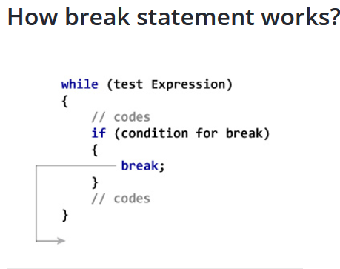

Slide 30

switch Statement
Day= Monday
Day= Sunday
No
Yes

Slide 31
switch Statement
The control statement that allows to make a decision from the number of choices is called switch.
Also called switch-case-default.
The switch statement provides another way to decide which statement to execute next.
The switch statement evaluates an expression, then attempts to match the result to one of several possible cases.
Each case contains a value and a list of statements.
The flow of control transfers to statement associated with the first case value that matches.

Slide 32
When a break statement is reached, the switch terminates, and the flow of control jumps to the next line following the switch statement.
Not every case needs to contain a break. If no break appears, the flow of control will fall through to subsequent cases until a break is reached.
A switch statement can have an optional default case, which must appear at the end of the switch. The default case can be used for performing a task when none of the cases is true. No break is needed in the default case.

Slide 33
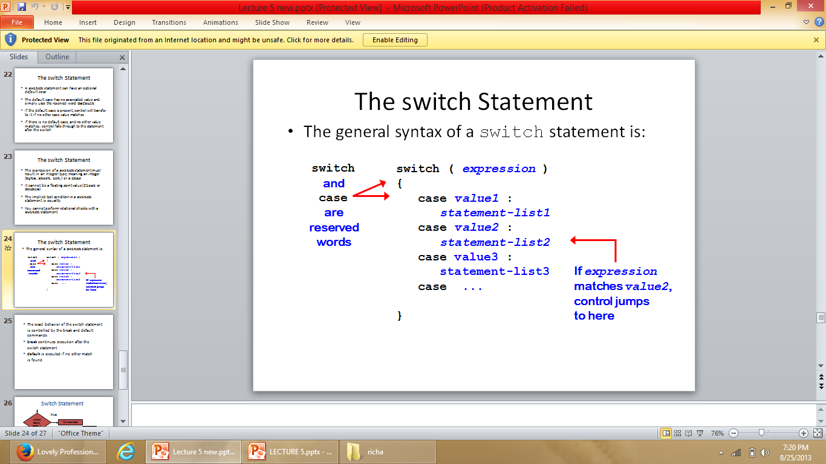
switch Statement
switch (expression)
{
case constant1:
statements;
break;
case constant2:
statements;
break;
case constant3:
statements;
break;
default:
statements;
}
Syntax

Slide 34
Rules of using switch case
Case label must be unique
Case label must end with colon
Case label must have constant expression
Case label must be of integer, character type like case 2, case 1+1, case ‘a’
Case label should not be floating point
Default can be placed anywhere in switch
Multiple cases cannot use same expression
Relational operators are not allowed in switch
Nesting of switch is allowed.
Variables are not allowed in switch case label.

Slide 35
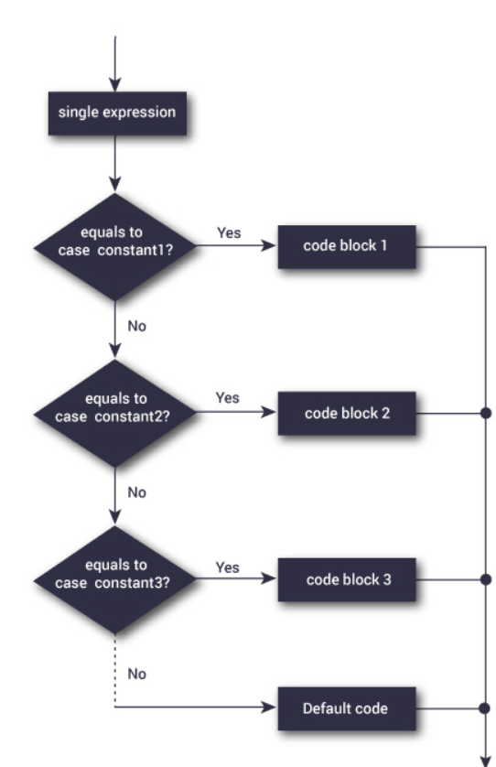
Switch workflow

Slide 36
Syntax error in switch statement
Variable cannot be used as label
switch(pt){
case count:
printf(“%d”, count);
break;
case 1<8:
printf(“A point”);
break;
case 2.5:
printf(“A line”);
break;
case 3 + 7.7:
printf(“A triangle”);
case 3 + 7.7:
printf(“A triangle”);
break;
case count+5:
printf(“A pentagon”);
break;
}
Relational operators are not allowed
Floating point number cannot be used
Floating point number cannot be used and same expression cannot be used
constant expression should be used

Slide 37
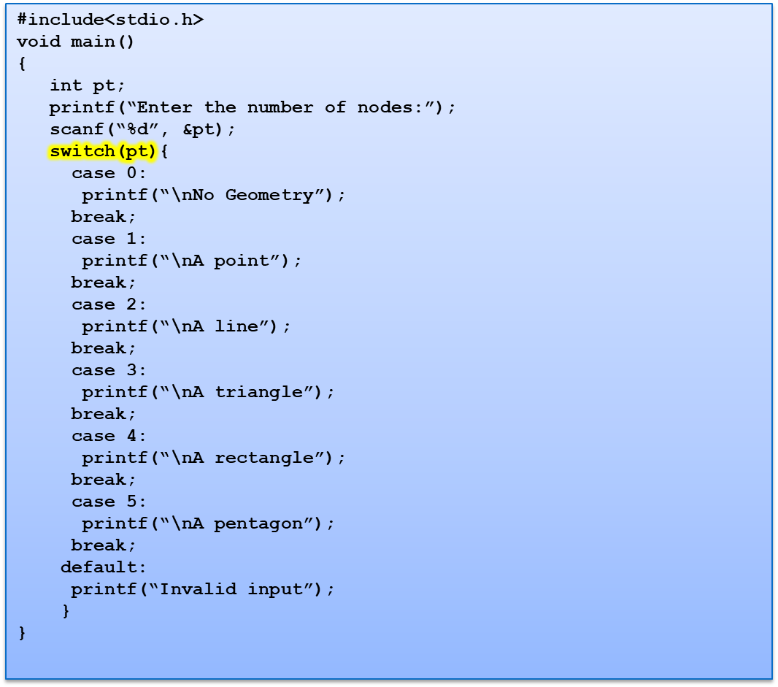
Program to show switch statement in geometry
Enter the number of nodes: 2
A line

Slide 38
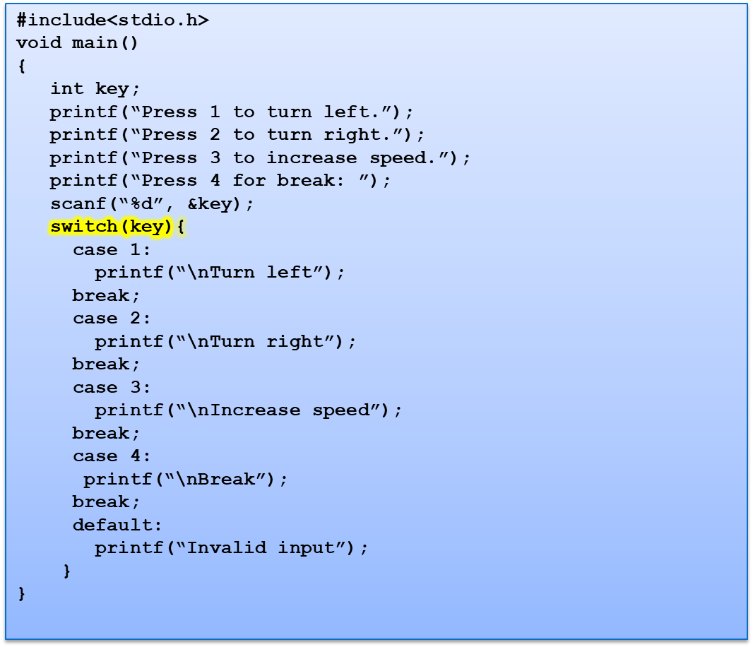
Program to move a car in car game
Quick yak:
Switch can be used to build a basic calculator:
Enter two numbers
Select operation 1. ADD, 2. SUBS, 3. MULT, 4. DIV
Press 1 to turn left.
Press 2 to turn right.
Press 3 to increase speed.
Press 4 for break: 4
Break

Slide 39
Difference between switch and if:
if statements can evaluate float conditions; switch statements cannot evaluate float conditions.
if statement can evaluate relational operators, switch statement cannot evaluate relational operators i.e. they are not allowed in switch statement.

Slide 40
Next Class: Loop control and Jump statements

